Slide 1
ARTIFICIAL INTELLIGENCE
9
Neural Networks
Handayani Tjandrasa

Slide 2
NEURON

Slide 3
Perceptron

Slide 4
PERCEPTRON
a_{o}
+1
w_{j0}
a₁
w_{j1}
w_{j2}
a₂
S_{j}
f(S_{j})
X_{j}
w_{jn}
a_{n}

Slide 5
Fungsi Aktivasi Threshold

Slide 6
Fungsi Aktivasi Linier

Slide 7
Fungsi Aktivasi Nonlinier

Slide 8
NEURON(PERCEPTRON)
y₁
w_{1j}
w_{2j}
y₂
w_{3j}
O
y₃
y_{i}
w_{ij}
Neuron mempunyai input2 terbobot dari neuron lain
Sinyal2 input membentuk penjumlahan terbobot
Tiap neuron mempunyai harga ambang (gambar diatas unit step) bila terlewati neuron teraktivasi

Slide 9
Neuron dengan Fungsi Threshold f(x)
y₁
w_{1j}
w_{2j}
y₂
w_{3j}
f(x)
O
y₃
y_{i}
w_{ij}

Slide 10
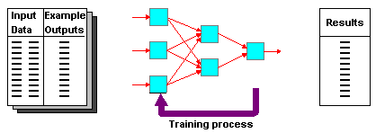

Perceptron termasuk Supervised Learning

Slide 11
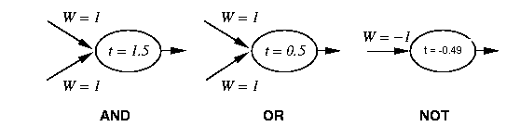
Contoh Perceptron Sederhana: AND, OR, NOT

Slide 12
Perceptron
x₀₌₁
x₁
w₁
w₀
w₂
x₂
Σ
y
.
.
.
^{n}
Σ w_{i} x_{i}
w_{n}
_{i=0}
x_{n}
^{n}
1 if Σ w_{i} x_{i} >0
y(x_{i})=
-1 otherwise
{
_{i=0}

Slide 13
Perceptron Learning
Bila output yang dihitung sama dengan target, bobot w_{i} tidak diubah, bila tidak sama bobot w_{i} are diubah sehingga output lebih mendekati target:
w_{i} = w_{i} + Δw_{i}
Δw_{i} = η (t - y) x_{i}
: adalah bilangan konstan kecil yang disebut learning rate
t: adalah nilai target
y: adalah output perceptron

Slide 14
Jaringan Multilayer

Slide 15
SISO (Single Input Single Output)

Slide 16
Learning: Back-Propagation (BP)
Update weights:

Slide 17
Back-Propagation (BP)
error term: e

Slide 18
Back-Propagation

Slide 19
Back-Propagation

Slide 20
Back-Propagation

Slide 21
Back-Propagation

Slide 22
Back-Propagation

Slide 23
Back-Propagation

Slide 24
Back-Propagation

Slide 25
Back-Propagation

Slide 26
Contoh:Training Perceptron
-1
W₁ = ?
For AND
A B Output
0 0 0
0 1 0
1 0 0
1 1 1
x
t = 0.0
W₂ = ?
W₃ = ?
y

Slide 27
Training Perceptron
For AND
A B Output
0 0 0
0 1 0
1 0 0
1 1 1
-1
W₁ = 0.3
x
t = 0.0
W₂ = 0.5
W₃ =-0.4
y

Slide 28
Perceptron: Decision Surface
x₂
x₂
+
+
-
+
+
-
x₁
-
x₁
-
+
+
-
-
Linearly separable
Non-Linearly separable

Slide 29
Linear Separability
X₁
A
A
A
Decision
Boundary
B
A
A
B
B
B
A
B
A
B
B
X₂
B

Slide 30
Rugby players & Ballet dancers
Rugby ?
2
Height (m)
Ballet?
1
50
120
Weight (Kg)

Slide 31
Different Non-Linearly Separable Problems
Types of
Decision Regions
Exclusive-OR
Problem
Classes with
Meshed regions
Most General
Region Shapes
Structure
Single-Layer
Half Plane
Bounded By
Hyperplane
A
B
B
A
B
A
Two-Layer
Convex Open
Or
Closed Regions
A
B
B
A
B
A
Three-Layer
Arbitrary
(Complexity
Limited by No.
of Nodes)
A
B
B
A
B
A

Slide 32
Contoh Aplikasi OCR

Slide 33
TERIMA KASIH

